Slide 1

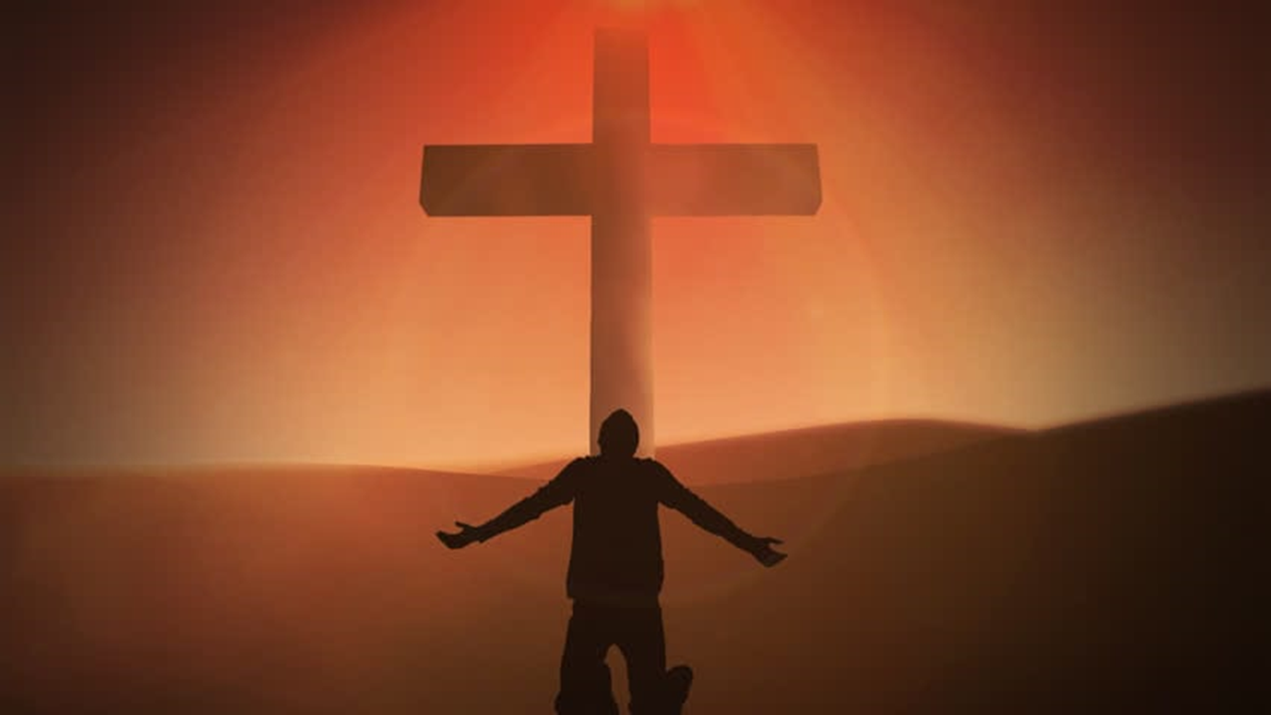
Apostle Dan Peters 7-6-25
This Photo by Unknown Author is licensed under CC BY
This Photo by Unknown Author is licensed under CC BY

Slide 2
ISSUE’S OF THE HEART
Hebrews 8:6
6 But now hath he obtained a more excellent ministry, by how much also he is the mediator of a better covenant, which was established upon better promises.

Slide 3
ISSUE’S OF THE HEART
Hebrews 8:10
10 For this is the covenant that I will make with the house of Israel after those days, saith the Lord; I will put my laws into their mind, and write them in their hearts: and I will be to them a God, and they shall be to me a people:

Slide 4
ABRAHAM TITHED TO MELCHIZEDEK
Gen 14:18-20
18 And Melchizedek king of Salem brought forth bread and wine: and he was the priest of the most high God.
19 And he blessed him, and said, Blessed be Abram of the most high God, possessor of heaven and earth:
20 And blessed be the most high God, which hath delivered thine enemies into thy hand. And he gave him tithes of all.

Slide 5
JACOB’S VOW
Genesis 28:16-22
16 And Jacob awaked out of his sleep, and he said, Surely the LORD is in this place; and I knew it not. 17 And he was afraid, and said, How dreadful is this place! this is none other but the house of God, and this is the gate of heaven. 18 And Jacob rose up early in the morning, and took the stone that he had put for his pillows, and set it up for a pillar, and poured oil upon the top of it. 19 And he called the name of that place Bethel: but the name of that city was called Luz at the first. 20 And Jacob vowed a vow, saying, If God will be with me, and will keep me in this way that I go, and will give me bread to eat, and raiment to put on, 21 So that I come again to my father's house in peace; then shall the LORD be my God: 22 And this stone, which I have set for a pillar, shall be God's house: and of all that thou shalt give me I will surely give the tenth unto thee.

Slide 6
COVENANT
Psalm 50:16-23 (KJV)
¹⁶ But unto the wicked God saith, What hast thou to do to declare my statutes, or that thou shouldest take my covenant in thy mouth?
¹⁷ Seeing thou hatest instruction, and castest my words behind thee.
²³ Whoso offereth praise glorifieth me: and to him that ordereth his conversation aright will I shew the salvation of God.

Slide 7
COVENANT
Jeremiah 1:12 (KJV)
¹² Then said the LORD unto me, Thou hast well seen: for I will hasten my word to perform it.

Slide 8
THE WEDDING
Matthew 22:11-14 (AMP)
¹¹ But when the king came in to view the guests, he looked intently at a man there who had on no wedding garment.¹² And he said, Friend, how did you come in here without putting on the [appropriate] wedding garment? And he was speechless (muzzled, gagged). ¹³ Then the king said to the attendants, Tie him hand and foot, and throw him into the darkness outside; there will be weeping and grinding of teeth. ¹⁴ For many are called (invited and summoned), but few are chosen.

Slide 9
RECORD KEPT OF YOUR DEEDS
Revelation 2:3-5 (AMP)
³ I know you are enduring patiently and are bearing up for My name's sake, and you have not fainted or become exhausted or grown weary. ⁴ But I have this [one charge to make] against you: that you have left (abandoned) the love that you had at first [you have deserted Me, your first love]. ⁵ Remember then from what heights you have fallen. Repent (change the inner man to meet God's will) and do the works you did previously [when first you knew the Lord], or else I will visit you and remove your lampstand from its place, unless you change your mind and repent.

Slide 10
RECORD KEPT OF YOUR DEEDS
Jeremiah 17:7-10 (KJV)
⁷ Blessed is the man that trusteth in the LORD, and whose hope the LORD is. ⁸ For he shall be as a tree planted by the waters, and that spreadeth out her roots by the river, and shall not see when heat cometh, but her leaf shall be green; and shall not be careful in the year of drought, neither shall cease from yielding fruit. ⁹ The heart is deceitful above all things, and desperately wicked: who can know it? ¹⁰ I the LORD search the heart, I try the reins, even to give every man according to his ways, and according to the fruit of his doings.

Slide 11
SIN REMAIN’S UNTIL CONFESSION IS MADE
Psalm 32:5-6 (GW)
⁵ I made my sins known to you, and I did not cover up my guilt. I decided to confess them to you, O LORD. Then you forgave all my sins. Selah ⁶ For this reason let all godly people pray to you when you may be found. Then raging floodwater will not reach them.

Slide 12
JESUS CALLING
Mark 8:34 (AMP)
³⁴ And Jesus called [to Him] the throng with His disciples and said to them, If anyone intends to come after Me, let him deny himself [forget, ignore, disown, and lose sight of himself and his own interests] and take up his cross, and [joining Me as a disciple and siding with My party] follow with Me [continually, cleaving steadfastly to Me].

Slide 13
A WORLD PASSING AWAY
1 John 2:15-17 (NASB)
¹⁵ Do not love the world nor the things in the world. If anyone loves the world, the love of the Father is not in him. ¹⁶ For all that is in the world, the lust of the flesh and the lust of the eyes and the boastful pride of life, is not from the Father, but is from the world. ¹⁷ The world is passing away, and also its lusts; but the one who does the will of God lives forever.

Slide 14
SPEAKING THE WORDS OF GOD
John 3:34-36 (NASB)
³⁴ "For He whom God has sent speaks the words of God; for He gives the Spirit without measure. ³⁵ "The Father loves the Son and has given all things into His hand. ³⁶ "He who believes in the Son has eternal life; but he who does not obey the Son will not see life, but the wrath of God abides on him."

Slide 15
OWE NO MAN ANY THING
Romans 13:7-11 (KJV)
⁷ Render therefore to all their dues: tribute to whom tribute is due; custom to whom custom; fear to whom fear; honour to whom honour.⁸ Owe no man any thing, but to love one another: for he that loveth another hath fulfilled the law. ⁹ For this, Thou shalt not commit adultery, Thou shalt not kill, Thou shalt not steal, Thou shalt not bear false witness, Thou shalt not covet; and if there be any other commandment, it is briefly comprehended in this saying, namely, Thou shalt love thy neighbour as thyself. ¹⁰ Love worketh no ill to his neighbour: therefore love is the fulfilling of the law. ¹¹ And that, knowing the time, that now it is high time to awake out of sleep: for now is our salvation nearer than when we believed.

Slide 16
OWE NO MAN ANY THING
Isaiah 64:7-8 (NASB)
⁷ There is no one who calls on Your name, Who arouses himself to take hold of You; For You have hidden Your face from us And have delivered us into the power of our iniquities. ⁸ But now, O LORD, You are our Father, We are the clay, and You our potter; And all of us are the work of Your hand.

