Slide 1
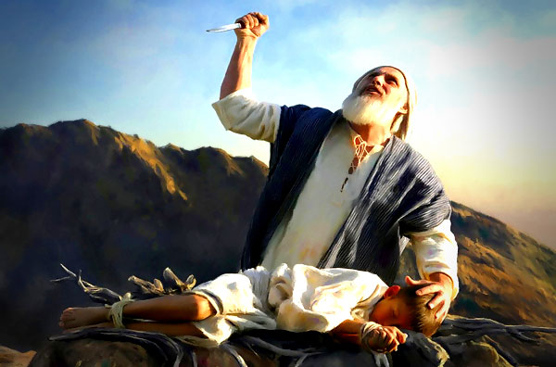


ABRAHAM’S COVENANT OF FAITH
Apostle Dan Peters 7-17-22
This Photo by Unknown Author is licensed under CC BY-NC-ND
This Photo by Unknown Author is licensed under CC BY
This Photo by Unknown Author is licensed under CC BY

Slide 2
ABRAHAM’S COVENANT OF FAITH
Acts 17:24-27 (KJV)
²⁴ God that made the world and all things therein, seeing that he is Lord of heaven and earth, dwelleth not in temples made with hands;
²⁵ Neither is worshipped with men's hands, as though he needed any thing, seeing he giveth to all life, and breath, and all things;
²⁶ And hath made of one blood all nations of men for to dwell on all the face of the earth, and hath determined the times before appointed, and the bounds of their habitation;
²⁷ That they should seek the Lord, if haply they might feel after him, and find him, though he be not far from every one of us:

Slide 3
ABRAHAM’S COVENANT OF FAITH
Galatians 4:28-31 (KJV)
²⁸ Now we, brethren, as Isaac was, are the children of promise.
²⁹ But as then he that was born after the flesh persecuted him that was born after the Spirit, even so it is now.
³⁰ Nevertheless what saith the scripture? Cast out the bondwoman and her son: for the son of the bondwoman shall not be heir with the son of the freewoman.
³¹ So then, brethren, we are not children of the bondwoman, but of the free.

Slide 4
NOW Faith
Hebrews 11:1-3(KJV)
¹ Now faith is the substance of things hoped for, the evidence of things not seen.
² For by it the elders obtained a good report.
³ Through faith we understand that the worlds were framed by the word of God, so that things which are seen were not made of things which do appear. .

Slide 5
DON’T BE FOOLISH
Galatians 3:1-29 (NASB)
¹ You foolish Galatians, who has bewitched you, before whose eyes Jesus Christ was publicly portrayed as crucified?
² This is the only thing I want to find out from you: did you receive the Spirit by the works of the Law, or by hearing with faith?
³ Are you so foolish? Having begun by the Spirit, are you now being perfected by the flesh?
⁶ Even so Abraham BELIEVED GOD, AND IT WAS RECKONED TO HIM AS RIGHTEOUSNESS.
⁷ Therefore, be sure that it is those who are of faith who are sons of Abraham.
⁹ So then those who are of faith are blessed with Abraham, the believer.

Slide 6
DON’T BE FOOLISH
Galatians 3:1-29 (NASB)
REDEEMED FROM THE CURSE 13 Christ redeemed us from the curse of the Law, having become a curse for us—for it is written, "CURSED IS EVERYONE WHO HANGS ON A TREE"—
¹⁴ in order that in Christ Jesus the blessing of Abraham might come to the Gentiles, so that we would receive the promise of the Spirit through faith.
²⁶ For you are all sons of God through faith in Christ Jesus.
²⁹ And if you belong to Christ, then you are Abraham's descendants, heirs according to promise.

Slide 7
THE PROMISE GRANTED BY FAITH
Romans 4:13-17 (HCSB)
¹³ For the promise to Abraham or to his descendants that he would inherit the world was not through the law, but through the righteousness that comes by faith.
¹⁷ in God’s sight. As it is written: I have made you the father of many nations. He believed in God, who gives life to the dead and calls things into existence that do not exist.

Slide 8
GOD RENEWS HIS COVENANT WITH ABRAHAM
Genesis 17:1-6 (KJV)
¹ And when Abram was ninety years old and nine, the LORD appeared to Abram, and said unto him, I am the Almighty God; walk before me, and be thou perfect.
² And I will make my covenant between me and thee, and will multiply thee exceedingly.
³ And Abram fell on his face: and God talked with him, saying,
⁴ As for me, behold, my covenant is with thee, and thou shalt be a father of many nations.
⁵ Neither shall thy name any more be called Abram, but thy name shall be Abraham; for a father of many nations have I made thee.
⁶ And I will make thee exceeding fruitful, and I will make nations of thee, and kings shall come out of thee.

Slide 9
THE RIGHTEOUSNESS OF GOD
Romans 3:19-31 (KJV)
¹⁹ Now we know that what things soever the law saith, it saith to them who are under the law: that every mouth may be stopped, and all the world may become guilty before God.
²⁰ Therefore by the deeds of the law there shall no flesh be justified in his sight: for by the law is the knowledge of sin.
prophets;
²² Even the righteousness of God which is by faith of Jesus Christ unto all and upon all them that believe: for there is no difference:
²³ For all have sinned, and come short of the glory of God; ³¹ Do we then make void the law through faith? God forbid: yea, we establish the law.

Slide 10
GOD’S APPROVAL BASED ON FAITH
Romans 10:6-11 (GW)
⁶ However, Scripture says about God's approval which is based on faith, “Don't ask yourself who will go up to heaven,” (that is, to bring Christ down).
⁹ If you declare that Jesus is Lord, and believe that God brought him back to life, you will be saved.
¹⁰ By believing you receive God's approval, and by declaring your faith you are saved.
¹¹ Scripture says, “Whoever believes in him will not be ashamed.”

Slide 11
YOUR INHERITANCE
2 Corinthians 1:20-22 (KJV)
²⁰ For all the promises of God in him are yea, and in him Amen, unto the glory of God by us.
²¹ Now he which stablisheth us with you in Christ, and hath anointed us, is God;
²² Who hath also sealed us, and given the earnest of the Spirit in our hearts.

Slide 12
FAITH THAT COMETH
Luke 18:7-8 (KJV)
⁷ And shall not God avenge his own elect, which cry day and night unto him, though he bear long with them?
⁸ I tell you that he will avenge them speedily. Nevertheless when the Son of man cometh, shall he find faith on the earth?

Slide 13
FAITH THAT COMETH
Romans 10:16-17 (KJV)
¹⁶ But they have not all obeyed the gospel. For Esaias saith, Lord, who hath believed our report?
¹⁷ So then faith cometh by hearing, and hearing by the word of God.

Slide 14
DON’T LEAVE EARTH WITHOUT IT
Hebrews 11:1-6 (KJV)
¹ Now faith is the substance of things hoped for, the evidence of things not seen.
³ Through faith we understand that the worlds were framed by the word of God, so that things which are seen were not made of things which do appear.
⁶ But without faith it is impossible to please him: for he that cometh to God must believe that he is, and that he is a rewarder of them that diligently seek him.

Slide 15
DON’T LEAVE EARTH WITHOUT IT
Ephesians 2:8 (AMP)
⁸ For it is by free grace (God's unmerited favor) that you are saved (delivered from judgment and made partakers of Christ's salvation) through [your] faith. And this [salvation] is not of yourselves [of your own doing, it came not through your own striving], but it is the gift of God;

Slide 16
ABRAHAM’S COVENANT OF FAITH
Apostle Dan Peters 7-17-22
This Photo by Unknown Author is licensed under CC BY-NC-ND
This Photo by Unknown Author is licensed under CC BY
This Photo by Unknown Author is licensed under CC BY

