Slide 1
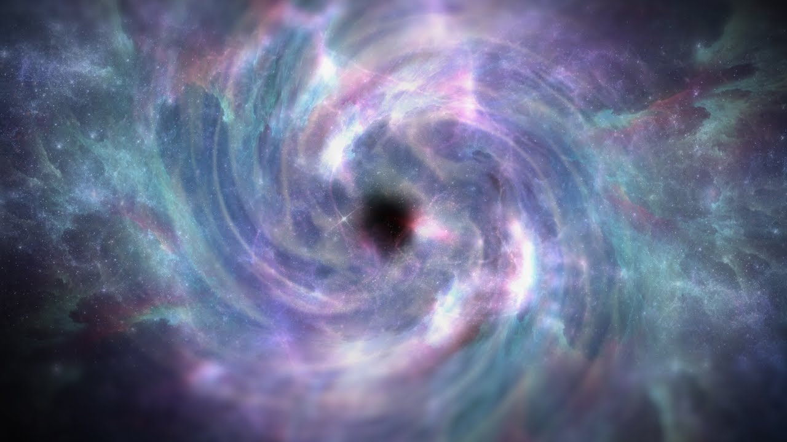

Ancient portals of heaven
Apostle Dan Peters 8-3-25
( Partnering With God )
This Photo by Unknown Author is licensed under CC BY
This Photo by Unknown Author is licensed under CC BY

Slide 2
1st Garden Temple
Genesis 2:8-10 (KJV)
⁸ And the LORD God planted a garden eastward in Eden; and there he put the man whom he had formed.
⁹ And out of the ground made the LORD God to grow every tree that is pleasant to the sight, and good for food; the tree of life also in the midst of the garden, and the tree of knowledge of good and evil.
¹⁰ And a river went out of Eden to water the garden; and from thence it was parted, and became into four heads.
Note: Mountain Garden/ Tree of Life/ Water of Life

Slide 3
JERUSALEM
Isaiah 2:1-5 (KJV)
¹ The word that Isaiah the son of Amoz saw concerning Judah and Jerusalem. ² And it shall come to pass in the last days, that the mountain of the LORD'S house shall be established in the top of the mountains, and shall be exalted above the hills; and all nations shall flow unto it. ³ And many people shall go and say, Come ye, and let us go up to the mountain of the LORD, to the house of the God of Jacob; and he will teach us of his ways, and we will walk in his paths: for out of Zion shall go forth the law, and the word of the LORD from Jerusalem. ⁴ And he shall judge among the nations, and shall rebuke many people: and they shall beat their swords into plowshares, and their spears into pruninghooks: nation shall not lift up sword against nation, neither shall they learn war any more. ⁵ O house of Jacob, come ye, and let us walk in the light of the LORD.

Slide 4
THE HELPER
Nehemiah 6:15-16 & 19
15 So the wall was finished in the twenty and fifth day of the month Elul, in fifty and two days.
16 And it came to pass, that when all our enemies heard thereof, and all the heathen that were about us saw these things, they were much cast down in their own eyes: for they perceived that this work was wrought of our God.
19 Also they reported his good deeds before me, and uttered my words to him. And Tobiah sent letters to put me in fear.

Slide 5
THE HELPER
Hebrews 13:5-6
5 Let your conversation be without covetousness; and be content with such things as ye have: for he hath said, I will never leave thee, nor forsake thee.
6 So that we may boldly say, The Lord is my helper, and I will not fear what man shall do unto me.

Slide 6
THE HELPER
Psalms 54:4
4 Behold, God is mine helper: the Lord is with them that uphold my soul.

Slide 7
PARTERING WITH GOD
John 15:13-16
13 Greater love hath no man than this, that a man lay down his life for his friends.
14 Ye are my friends, if ye do whatsoever I command you.
15 Henceforth I call you not servants; for the servant knoweth not what his lord doeth: but I have called you friends; for all things that I have heard of my Father I have made known unto you.
16 Ye have not chosen me, but I have chosen you, and ordained you, that ye should go and bring forth fruit, and that your fruit should remain: that whatsoever ye shall ask of the Father in my name, he may give it you.

Slide 8
THE SANTUARY OF GOD
Ezekiel 28:13-15 &18 (AMP)
¹³ You were in Eden, the garden of God; every precious stone was your covering, the carnelian, topaz, jasper, chrysolite, beryl, onyx, sapphire, carbuncle, and emerald; and your settings and your sockets and engravings were wrought in gold. On the day that you were created they were prepared.
¹⁴ You were the anointed cherub that covers with overshadowing [wings], and I set you so. You were upon the holy mountain of God; you walked up and down in the midst of the stones of fire [like the paved work of gleaming sapphire stone upon which the God of Israel walked on Mount Sinai].
¹⁵ You were blameless in your ways from the day you were created until iniquity and guilt were found in you.
¹⁸ You have profaned your sanctuaries by the multitude of your iniquities and the enormity of your guilt, by the unrighteousness of your trade. Therefore I have brought forth a fire from your midst; it has consumed you, and I have reduced you to ashes upon the earth in the sight of all who looked at you.

Slide 9
THE HOLY GHOST
Hebrews 9:8-11 (KJV)
⁸ The Holy Ghost this signifying, that the way into the holiest of all was not yet made manifest, while as the first tabernacle was yet standing:
¹¹ But Christ being come an high priest of good things to come, by a greater and more perfect tabernacle, not made with hands, that is to say, not of this building;

Slide 10
THE HOLY GHOST
Psalm 118:22-24 (KJV)
²² The stone which the builders refused is become the head stone of the corner.
²³ This is the LORD'S doing; it is marvellous in our eyes.
²⁴ This is the day which the LORD hath made; we will rejoice and be glad in it.
ll from him and went back and stood by the bank of the Jordan.

Slide 11
HEAVEN OPENED
Luke 3:21-22 (KJV)
²¹ Now when all the people were baptized, it came to pass, that Jesus also being baptized, and praying, the heaven was opened,
²² And the Holy Ghost descended in a bodily shape like a dove upon him, and a voice came from heaven, which said, Thou art my beloved Son; in thee I am well pleased.

Slide 12
THE SCEPTER
Hebrews 1:5-8 (AMP)
⁵ For to which of the angels did [God] ever say, You are My Son, today I have begotten You [established You in an official Sonship relation, with kingly dignity]? And again, I will be to Him a Father, and He will be to Me a Son?
⁶ Moreover, when He brings the firstborn Son again into the habitable world, He says, Let all the angels of God worship Him.
⁷ Referring to the angels He says, [God] Who makes His angels winds and His ministering servants flames of fire;
⁸ But as to the Son, He says to Him, Your throne, O God, is forever and ever (to the ages of the ages), and the scepter of Your kingdom is a scepter of absolute righteousness (of justice and straightforwardness).

Slide 13
THE SCEPTER
John 1:51 (KJV)
⁵¹ And he saith unto him, Verily, verily, I say unto you, Hereafter ye shall see heaven open, and the angels of God ascending and descending upon the Son of man.

Slide 14
ANCIENT PATHS
Jeremiah 6:16 (ESV)
16 Thus says the Lord: “Stand by the roads, and look, and ask for the ancient paths, where the good way is; and walk in it, and find rest for your souls.

Slide 15
A GATEWAY TO HEAVEN
Genesis 28:12 (AMP)
12 And he dreamed that there was a ladder set up on the earth, and the top of it reached to heaven; and the angels of God were ascending and descending on it! .

Slide 16
A GATEWAY TO HEAVEN
Genesis 28:15-17 (AMP)
15 And behold, I am with you and will keep (watch over you with care, take notice of) you wherever you may go, and I will bring you back to this land; for I will not leave you until I have done all of which I have told you. 16 And Jacob awoke from his sleep and he said, Surely the Lord is in this place and I did not know it. 17 He was afraid and said, How to be feared and reverenced is this place! This is none other than the house of God, and this is the gateway to heaven

