Slide 1
SIGNS AND SEASONS
19 For the goodman is not at home, he is gone a long journey: 20 He hath taken a bag of money with him, and will come home at the day appointed.
Prov 7:19-20 (KJV)
# 3677 (kece)', The full moon, its festival:---(time) appointed....
SIGNS AND SEASONS
14 And God said, Let there be lights in the firmament of the heaven to divide the day from the night; and let them be for signs, and for seasons, and for days, and years:
Gen 1:14 (KJV)
SIGNS defined as “OWTH 0225” = (sence of appearing, to come); a signal as a flag,beacon,monument,omen,prodigy,evidence,etc,:---mark,miracle, a token...
SEASONS defined “MOW'ED 4150 “ properly,an appointment,i.e. A fixed time or season; specifically, a festival;

Slide 2
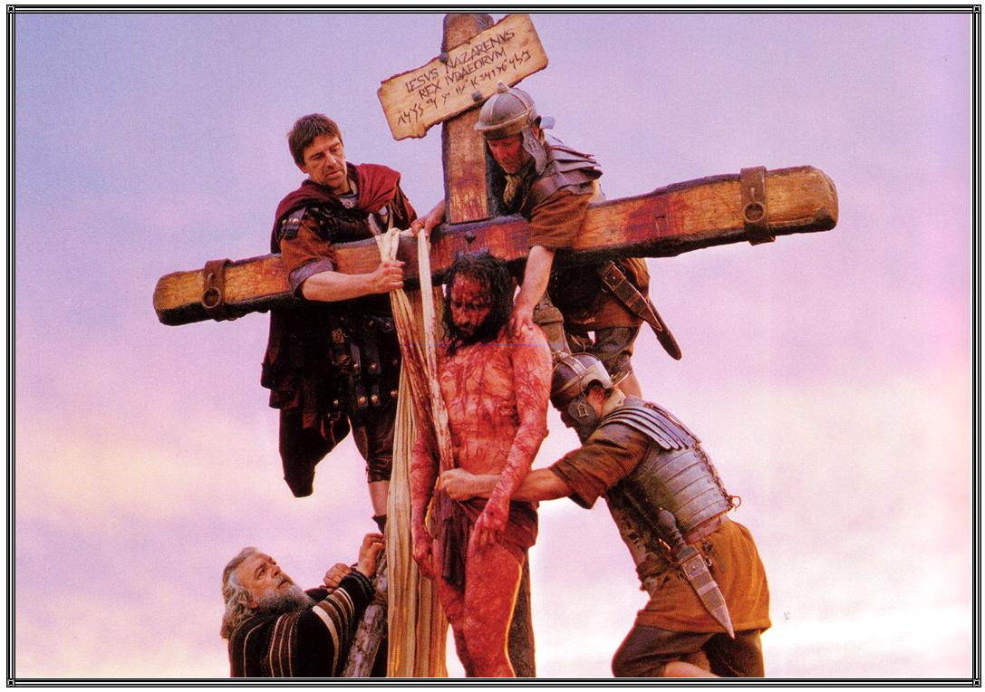
4-3-33 AD PASSOVER

Slide 3
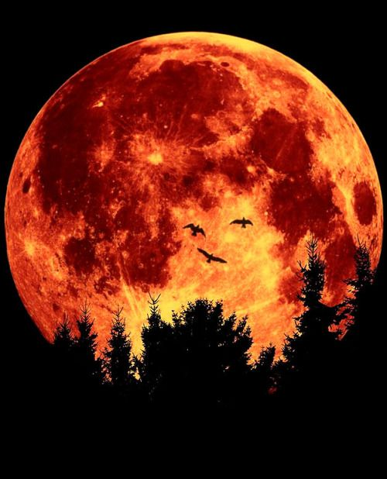
BLOOD MOON ( JOEL 2:30-32 )

Slide 4
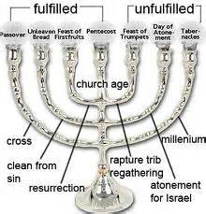

Slide 5
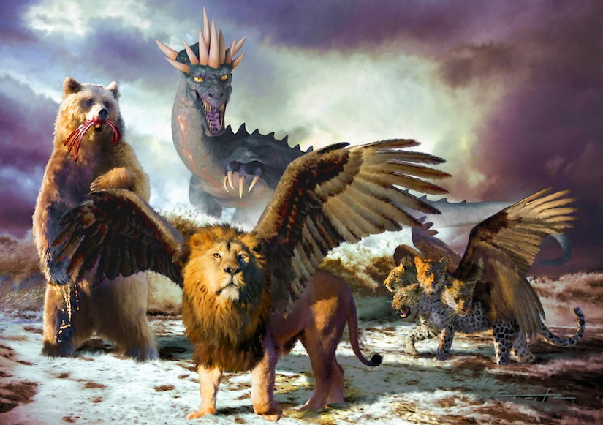
SEAL UP THE VISION UNTIL THE END

Slide 6
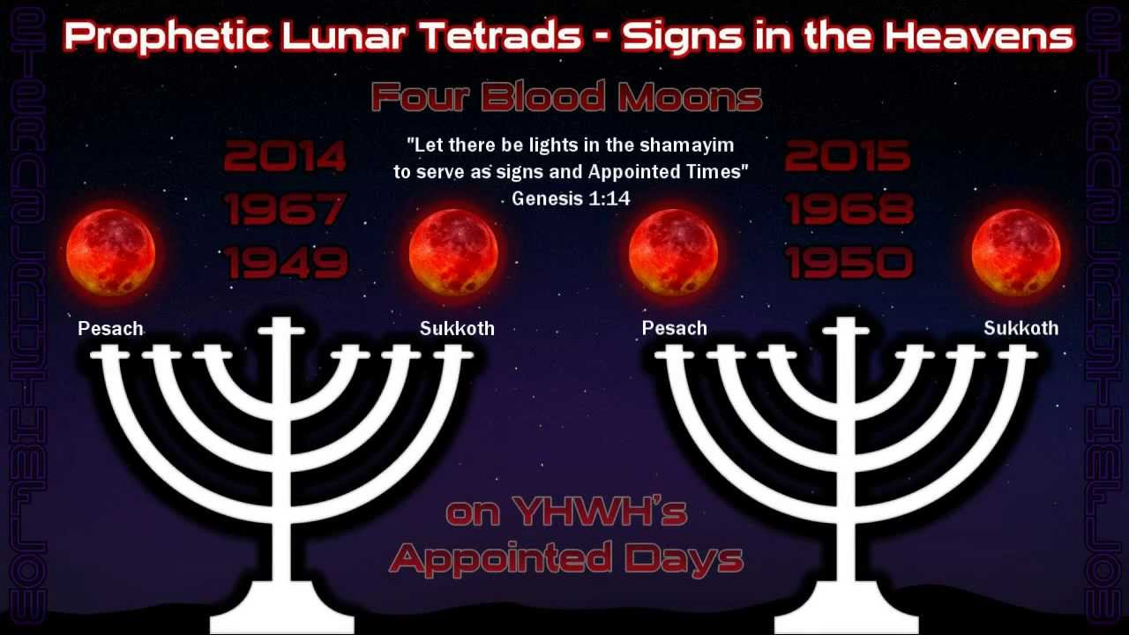

Slide 7
SIGN’S IN THE SUN,MOON & STARS
Luke 21:25-27 (KJV)
²⁵ And there shall be signs in the sun, and in the moon, and in the stars; and upon the earth distress of nations, with perplexity; the sea and the waves roaring;
²⁶ Men's hearts failing them for fear, and for looking after those things which are coming on the earth: for the powers of heaven shall be shaken.
²⁷ And then shall they see the Son of man coming in a cloud with power and great glory.

Slide 8
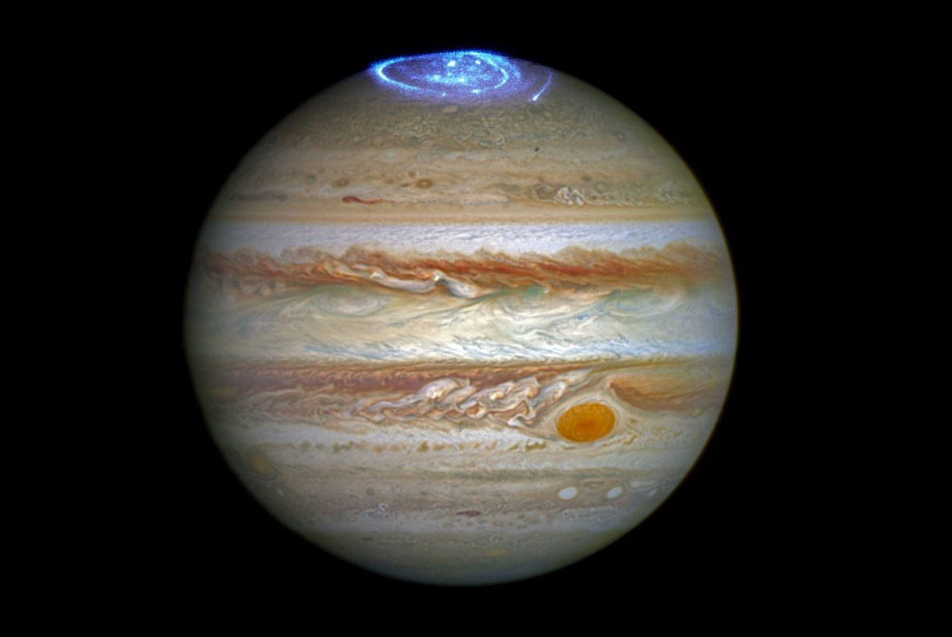
Jupiter’s Crown

Slide 9
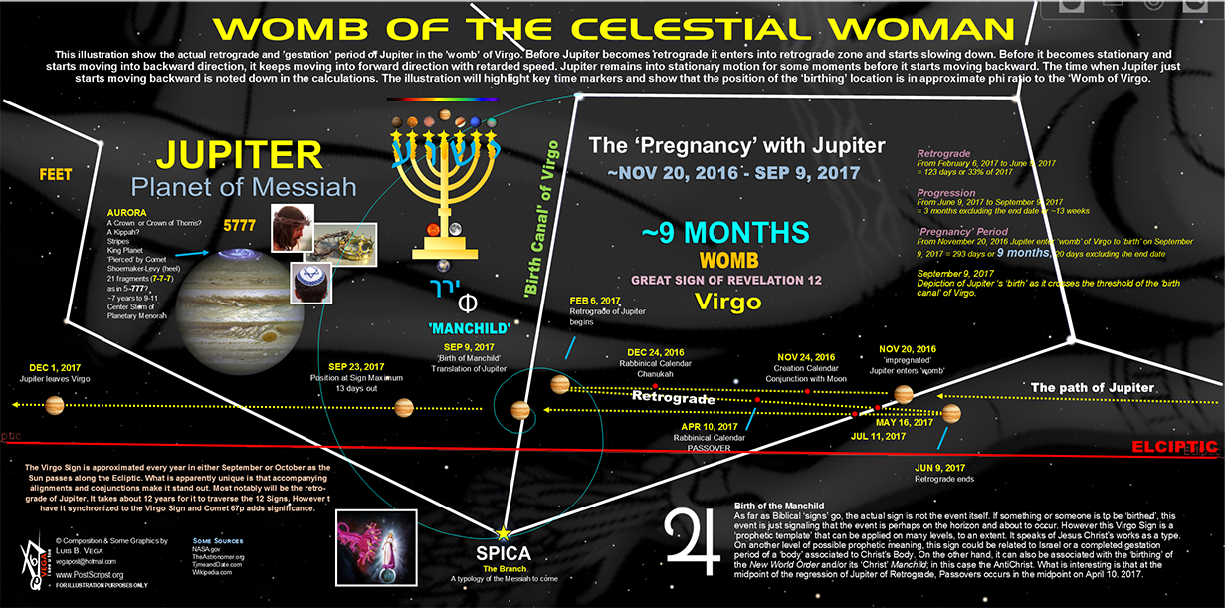

Slide 10
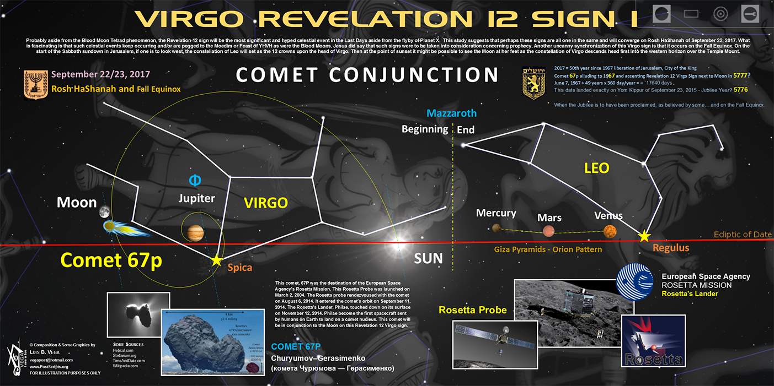

Slide 11
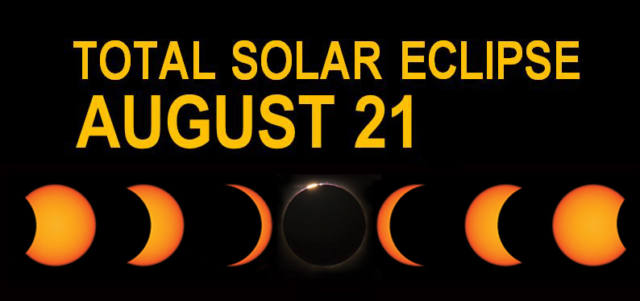

Slide 12
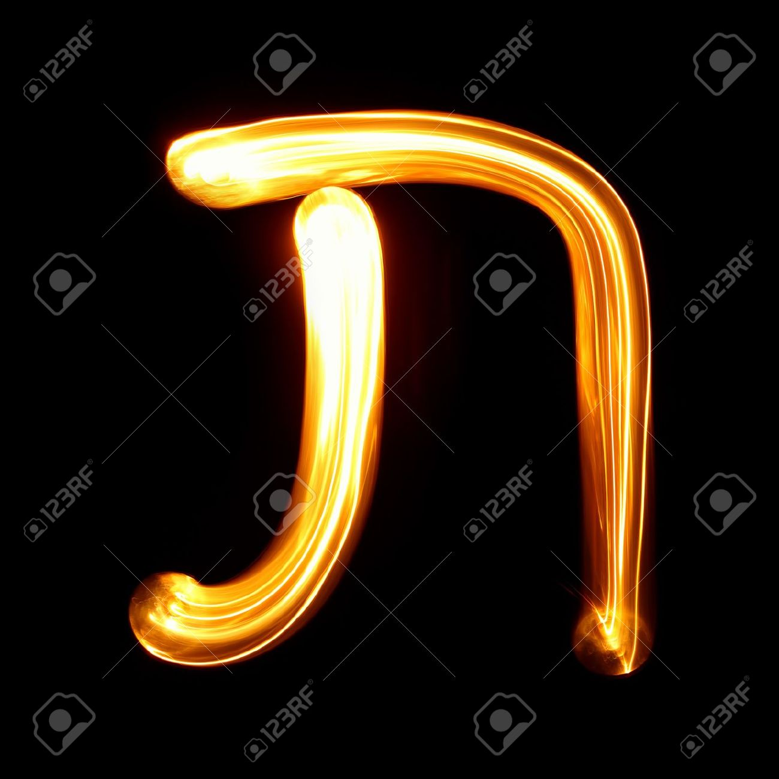
HEBREW LETTER FOR 400 (TAV)

Slide 13
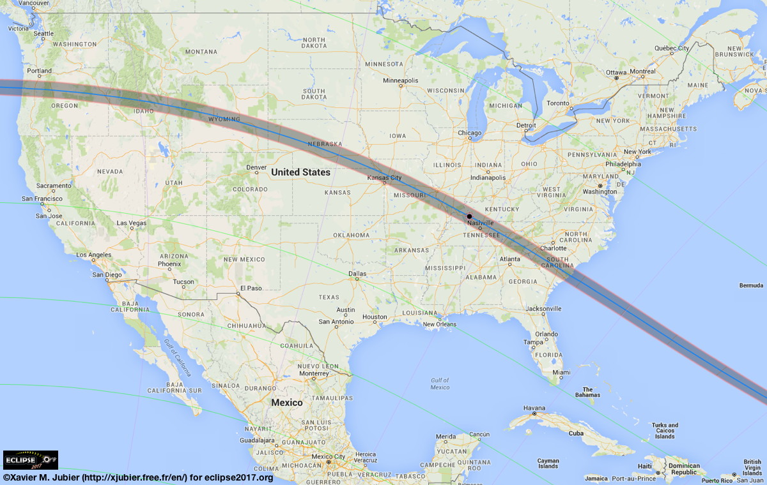
AMERICA’S ECLIPSE 8-21-17

Slide 14
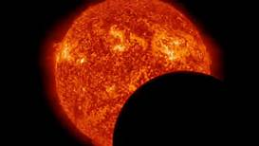

Slide 15
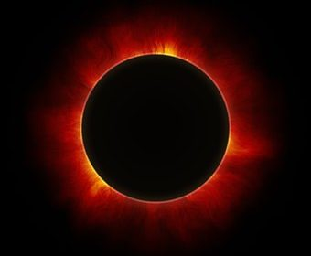

Slide 16
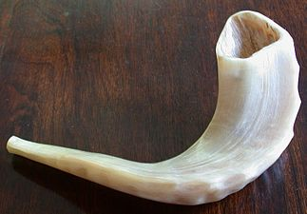
ELUL ( CALL OF REPENTANCE) HOLY DAYS

Slide 17
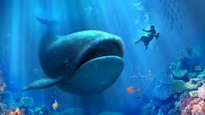
JONAH 1:12

Slide 18
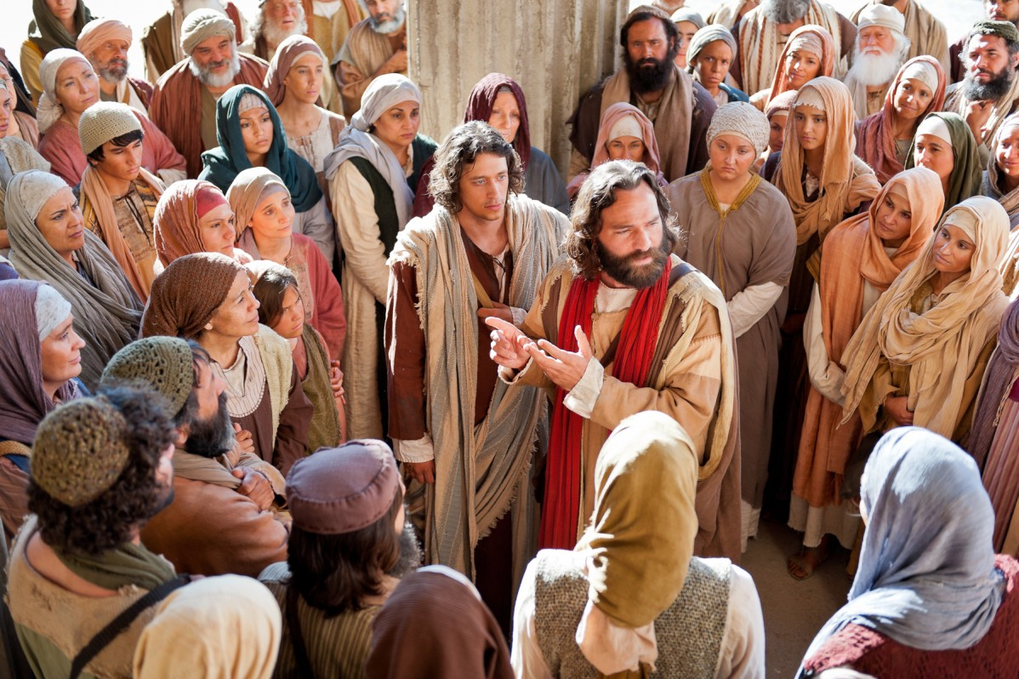
JONAH 3:4 (40 DAYS TILL JUDGEMENT)

Slide 19
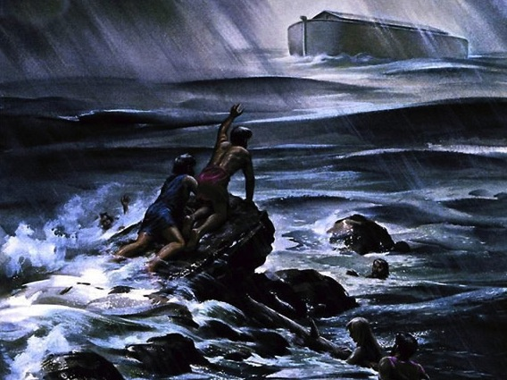
NOAH’S FLOOD

Slide 20
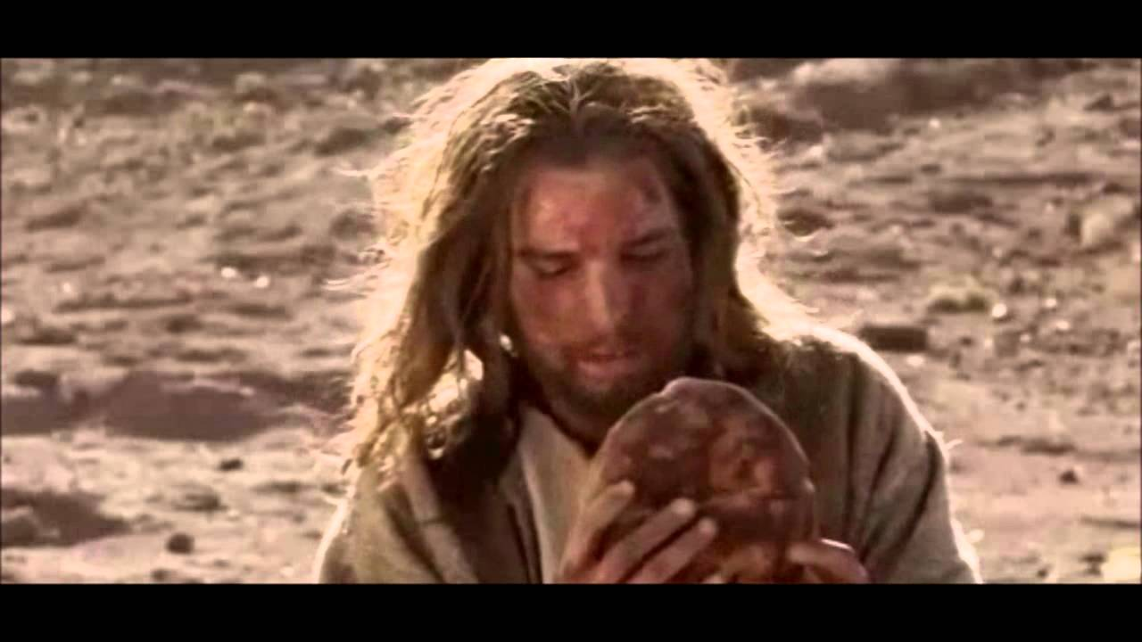
JESUS TEMPTATION IN THE WILDERNESS

Slide 21
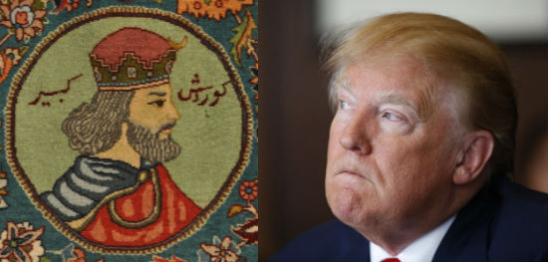
KING CYRUS/ ISAIAH 45/ 45TH PRESIDENT

Slide 22
THE DAY OF THE LORD
Joel 2:30-32 (KJV)
³⁰ And I will shew wonders in the heavens and in the earth, blood, and fire, and pillars of smoke.
³¹ The sun shall be turned into darkness, and the moon into blood, before the great and the terrible day of the LORD come.
³² And it shall come to pass, that whosoever shall call on the name of the LORD shall be delivered: for in mount Zion and in Jerusalem shall be deliverance, as the LORD hath said, and in the remnant whom the LORD shall call.

Slide 23
Great Wonder in Heaven
1 And there appeared a great wonder in heaven; a woman clothed with the sun, and the moon under her feet, and upon her head a crown of twelve stars:
2 And she being with child cried, travailing in birth, and pained to be delivered.
Rev 12:1-2 (KJV)

Slide 24
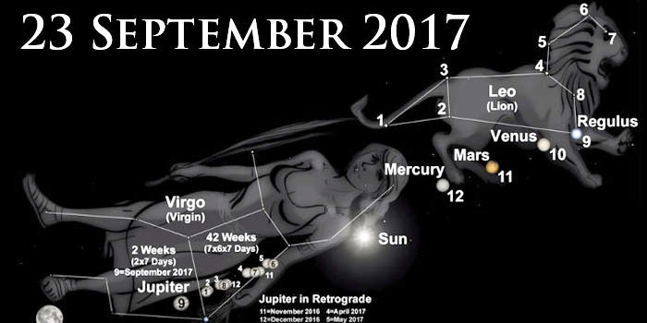

Slide 25
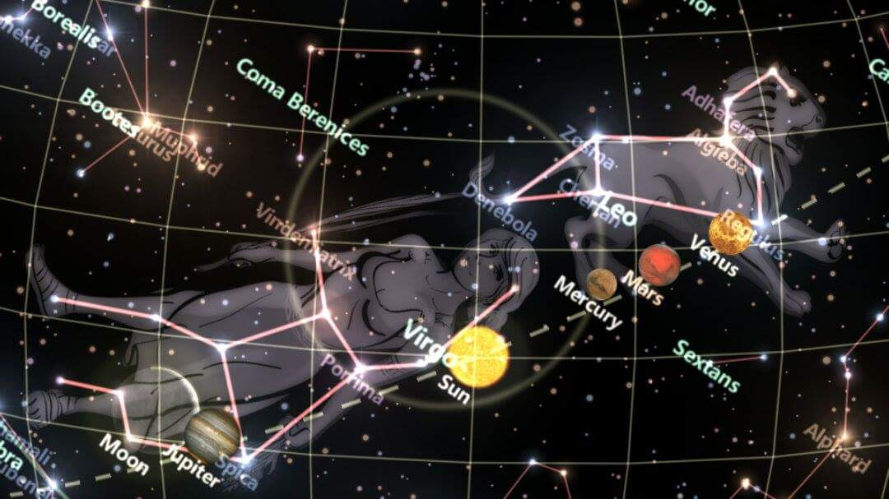

Slide 26
