Slide 1
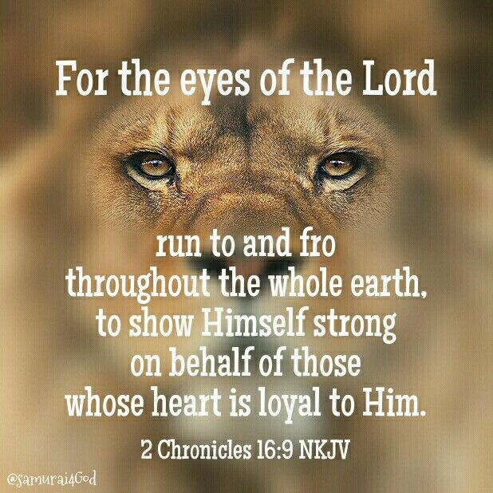
Election & Calling
(A Perfect Heart)
Apostle Daniel Peters

Slide 2
Election and Calling
(A Perfect Heart)
2 Chronicles 16:9a) (KJV)
⁹ For the eyes of the LORD run to and fro throughout the whole earth, to shew himself strong in the behalf of them whose heart is perfect toward him.
Jeremiah 29:11-13 (KJV)
¹¹ For I know the thoughts that I think toward you, saith the LORD, thoughts of peace, and not of evil, to give you an expected end.
¹² Then shall ye call upon me, and ye shall go and pray unto me, and I will hearken unto you.
¹³ And ye shall seek me, and find me, when ye shall search for me with all your heart

Slide 3
Prosperity
Psalm 35:27 (KJV)
²⁷ Let them shout for joy, and be glad, that favour my righteous cause: yea, let them say continually, Let the LORD be magnified, which hath pleasure in the prosperity of his servant.
Ezekiel 37:26 (AMP)
²⁶ I will make a covenant of peace with them; it shall be an everlasting covenant with them, and I will give blessings to them and multiply them and will set My sanctuary in the midst of them forevermore.

Slide 4
Return to Him
Isaiah 55:6-8 (KJV)
⁶ Seek ye the LORD while he may be found, call ye upon him while he is near:
⁷ Let the wicked forsake his way, and the unrighteous man his thoughts: and let him return unto the LORD, and he will have mercy upon him; and to our God, for he will abundantly pardon.
⁸ For my thoughts are not your thoughts, neither are your ways my ways, saith the LORD

Slide 5
The New Creation
2 Cor 5:17 (TAB)
Therefore if any person is [ingrafted] in Christ (the Messiah) he is anew creation {a new creation altogether) ; the old [previous moral and spiritual condition has passed away. Behold, the fresh and new has come! 18 But all things are from God, Who through Jesus Christ reconciled us to Himself [received us into favor, brought us into harmony with Himself] and gave us the ministry of reconciliation [that by word and deed we might aim to bring others into harmony with Him]. 19 It was God [personally present] in Christ, reconciling and restoring the world to favor with Himself ,not counting up and holding against [men] their trespasses [but canceling them] and committing to us the message of reconciliation (of the restoration to favor).

Slide 6
Ministry of Reconciliation
Matt 5:12 (Message)
Let me tell you why you are here. You’re here to be salt-seasoning that brings out the God-flavors of this earth. If you lose your saltiness, how will people taste godliness? You’re lost your usefulness and will end up in the garbage…
“Here’s another way to put it: You’re here to be light, bringing out the God –colors in the world. God is not a secret to be kept. We’re going public with this, as public as a city on a hill. If I make you light-bearers, you don’t think I’m going to hide you under a bucket, do you? I’m putting you on a light stand. Now that I’ve put you there on a hilltop, on a light stand shine!”

Slide 7
Many Are Called. Few Are Chosen
Matt 22: 2
The kingdom of heaven is like unto a certain king, which made a marriage for his son, 3 And sent forth his servants to call them that were bidden to the wedding: and they would not come.
5 But they made light of [it], and went their ways
14 For many are called , but few [ are ] chosen .

Slide 8
How Does God Choose?
Acts 7:38
This is he, that was in the church in the wilderness with the angel which spake to him in the mount Sina, and [with] our fathers: who received the lively oracles to give unto us:
Just as Jethro instructed Moses’ in the Wilderness, is the same way that Paul instructs Timothy…
2 Tim 2:2
And the things that thou hast heard of me among many witnesses, the same commit thou to faithful men , who shall be able to teach others also.
Ex 18:21
ABLE MEN… FEAR GOD… MEN OF TRUTH …HATING COVETOUSNESS…

Slide 9
God Examines the Heart
John 15: 16
Ye have not chosen me, but I have chosen you , and ordained you , that ye should go and bring forth fruit, and [that] your fruit should remain: that whatsoever ye shall ask of the Father in my name, he may give it you .
1 John 4:19
We love him, because he first loved us…
John 6:44
No man can come to me, except the Father which hath sent me draw him:

Slide 10
God Chose David
1 Sam 16:7
But the LORD said unto Samuel , Look not on his countenance, or on the height of his stature; because I have refused him: for [the LORD seeth] not as man seeth; for man looketh on the outward appearance, but the LORD looketh on the heart.

Slide 11
God Knew You Before You Were Born
Jer 1:4
Then the word of the LORD came unto me, saying, 5 Before I formed thee in the belly I knew thee; and before thou camest forth out of the womb I sanctified thee, [and] I ordained thee a prophet unto the nations .

Slide 12
Election and Calling
2 Peter 1 :10
Wherefore the rather, brethren, give diligence to make your calling and election sure: for if ye do these things, ye shall never fall: 11 For so an entrance shall be ministered unto you abundantly into the everlasting kingdom of our Lord and Saviour Jesus Christ.
A calling can be seasonal ; God can call you to a Mission Trip; God can call you to Teach a Bible study; But your Election is your Final Destiny…
1 Tim 1:9 (TAB)
[For it is He] Who delivered and saved us and called us with a calling in itself holy and leading to holiness [to a life of concentration, a vocation of holiness]; [He did it] not because of anything of merit that we have done, but because of and to further His own purpose and grace (unmerited favor) which was given us in Christ Jesus before the world began [eternal ages ago].

Slide 13
Saving Grace
Eph 2:4
But God, who is rich in mercy, for his great love wherewith he loved us
6 And hath raised [us] up together, and made [us] sit together in heavenly [places] in Christ Jesus:
8 For by grace are ye saved through faith; and that not of yourselves: [it is] the gift of God: 9 Not of works , lest any man should boast.

Slide 14
What If I Failed God
Romans 11: 29
For the gifts and calling of God [are] without repentance.
Eph 2:10 (TAB)
For we are God’s [own] handiwork (His workmanship), recreated in Christ Jesus ,[born anew] that we may do those good works which God predestined {planned beforehand) for us [taking paths which He prepared ahead of time]. That we should walk in them [living the good life which He prearranged and made ready for us to live]…
Psalms 138: 8
The LORD will perfect [that which] concerneth me: thy mercy, O LORD, [endureth] for ever: forsake not the works of thine own hands .

